Slide 1
Smart BACKPACK for contextual reminders and content monitoring

Slide 2
Agenda
Objective
Existing system
Proposed system
Components
Design Methodology diagrams

Slide 3
Objective
The IoT-based Smart Backpack (NeoPack) enhances user convenience and security by integrating smart technology. It provides real-time notifications for essential items, monitors battery levels of electronic devices, and ensures security against unauthorized access. By leveraging IoT, NFC, and sensor-based automation, the system helps users stay organized and prepared for daily activities efficiently.

Slide 4
EXISTING SYSTEM
Traditional backpacks serve only as storage solutions and lack intelligent features to assist users. The absence of smart functionalities leads to several challenges:
🔹 No Weather Awareness – Users often forget to check the weather forecast, leading to inconvenience during unexpected rain.
🔹 No Book Tracking System – There is no way to detect missing books before leaving, causing disruptions in academic or work schedules.
🔹 No Battery Monitoring – Users may not realize their devices (laptops, power banks) have low battery until it's too late.
🔹 No Security Alerts – Unauthorized access or theft of items inside the bag goes unnoticed due to a lack of security measures.

Slide 5
COMPARSION TABLE
Feature | Traditional Backpack | Smart Backpack (Proposed System)
Weather Awareness | No alerts for weather changes | Provides real-time weather alerts
Book Tracking | No way to detect missing books | Uses ESP32 C3 to identify missing books via Bluetooth communication
Battery Monitoring | No tracking of device battery levels | Sends low battery alerts
Security Features | No security measures for bag opening | Detects unauthorized access and sends alerts
User Notifications | Manual checking required | Automatic alerts and reminders via mobile app
IoT Integration | No smart technology used | Uses ESP32, NFC, and sensors for automation

Slide 6
Proposed System
Neopack is a smart bag integrating multiple intelligent features for enhanced daily usability. It retrieves real-time weather data to alert users about rain, prompting them to carry an umbrella. Using a custom EMI-triggered system, ESP32-C3 modules embedded in books broadcast via Bluetooth, allowing the ESP32-S3 in the bag to verify their presence and alert users if any book is missing. Neopack also monitors connected devices’ battery levels, sends low-battery alerts to the mobile app (NeoPulse), and tracks the bag’s weight, notifying users when it exceeds a safe limit. All features are integrated into a mobile app that provides real-time alerts and an intuitive dashboard for seamless interaction with the smart bag.

Slide 7
KEY FEATURES
1️⃣ Weather-Based Recommendation:
Retrieves real-time weather data using a Weather API.
Notifies users to carry an umbrella if rain is predicted.
2️⃣ Smart Book Reminder System:
ESP32-C3 modules in books are activated by the power rail’s EMI.
Alerts users if required books are missing before leaving in app as well as by haptic feedback
3️⃣ Battery Monitoring System
Monitors the battery levels of electronic devices such as laptops and power banks.
Sends a low battery alert to the mobile application, ensuring users charge their devices beforehand.

Slide 8
KEY FEATURES
4️⃣ Bag Weight Monitoring
Uses a Load Sensor to measure the total weight of the bag.
Alerts the user if the bag is too heavy, preventing excessive strain on the shoulders.
Helps ensure that all necessary items are inside without exceeding a comfortable carrying weight.
5️⃣ Mobile App Integration for Real-Time Alerts
Provides a user-friendly interface to display all notifications and alerts.
Offers an interactive dashboard to track book status, battery levels, and security notifications.
Ensures seamless interaction with the backpack’s smart features.

Slide 9







HARDWARE Components
Component | Purpose
ESP32-S3 | Acts as the central processing unit, handling all sensor inputs and communication.
ESP32-C3 | Inserted in books – when activated they send Bluetooth signals to the ESP32-S3
Load Sensor | Detects weight changes inside the bag to track missing books.
Battery Monitoring Sensor (INA219/ACS712) | Tracks the charge levels of electronic devices.
Haptic Feedback Module | Provides vibration alerts for security warnings or reminders.
Buzzer/LED Indicator | Provides sound or visual alerts for security notifications.
Rechargeable Battery Pack | Powers the ESP32-S3 and connected components.

Slide 10




SOFTWARE Components
Software | Purpose
Arduino IDE | Used for programming the ESP32-S3 microcontroller.
Supabase | Manages cloud database storage and authentication.
Mobile Application (React Native/Flutter) | Displays real-time notifications and provides an interactive interface.
Weather API | Fetches real-time weather data for umbrella recommendations.
NFC Data Processing Algorithm | Compares scanned book data with a predefined checklist.
Push Notification Service (Using ESP32 HTTP Requests) | Sends real-time alerts to the mobile app via Supabase.

Slide 11
DESIGN METHODOLOGY
Step 1 - Purpose & Requirements
Purpose:
A smart backpack system that helps users pack the right books using NFC technology, provides battery monitoring, and recommends an umbrella based on weather data.
Behavior:
Auto Mode: Scans NFC tags and checks against the timetable.
Manual Mode: User manually confirms packed items via the mobile app.
Additional Features: Battery alerts, real-time monitoring, and weight tracking.
System Requirements:
Real-time item tracking via the mobile app.
Push notifications for missing books, battery low, and heavy bag alerts.
Offline functionality with cloud syncing via Supabase.
Secure access with authentication and data encryption.

Slide 12
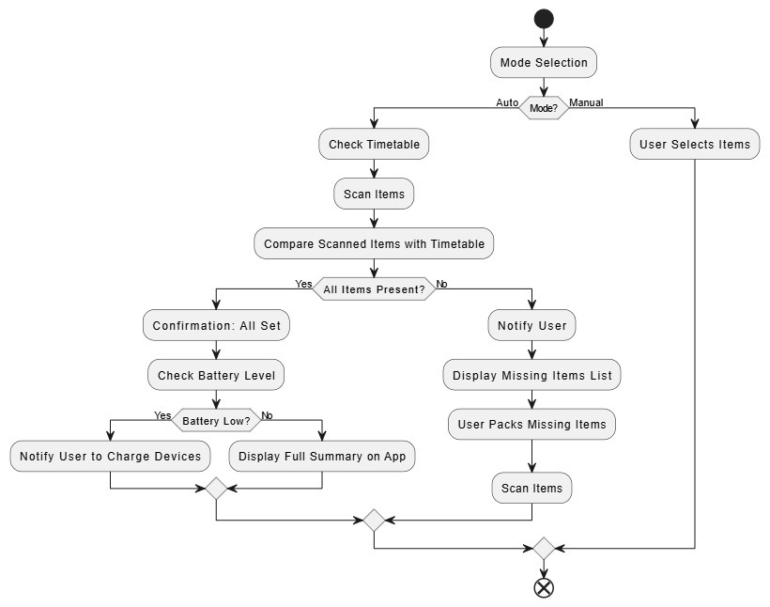
Step 2 – Process Model Specification
The flowchart represents the Working Process of the Smart Backpack System, which operates in two modes – Auto mode and Manual Mode.

Slide 13
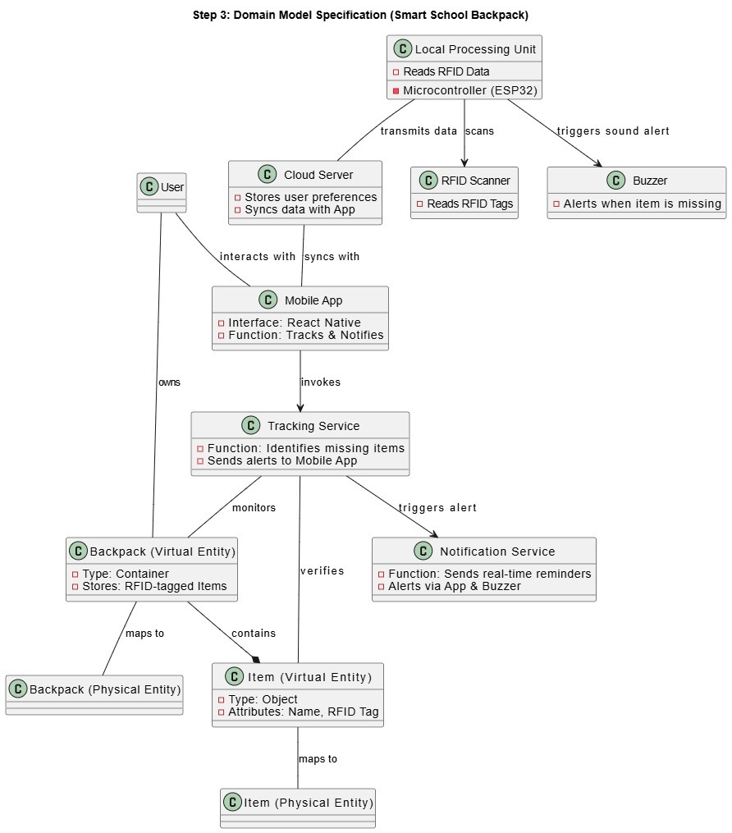
Step 3 – Domain Model Specification
The system connects users, a smart backpack, an RFID scanner, ESP32-S3, a cloud server, a tracking service, and a mobile app to ensure item tracking, alerts, and real-time notifications via the app and buzzer.

Slide 14
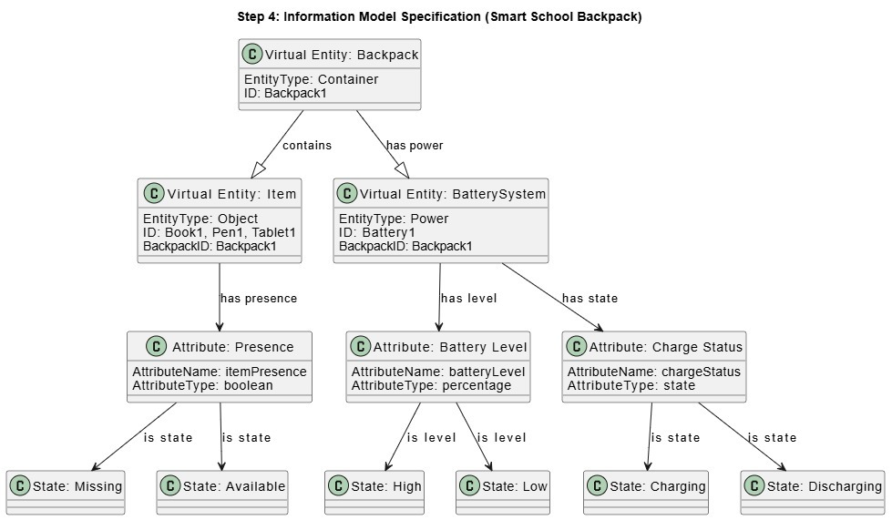
Step 4 – Information Model Specification
Defines Backpack (Container), Items (Objects), and Battery System (Power) with attributes like Presence (Item Availability), Battery Level (Percentage), and Charge Status (State: Charging / Discharging).

Slide 15
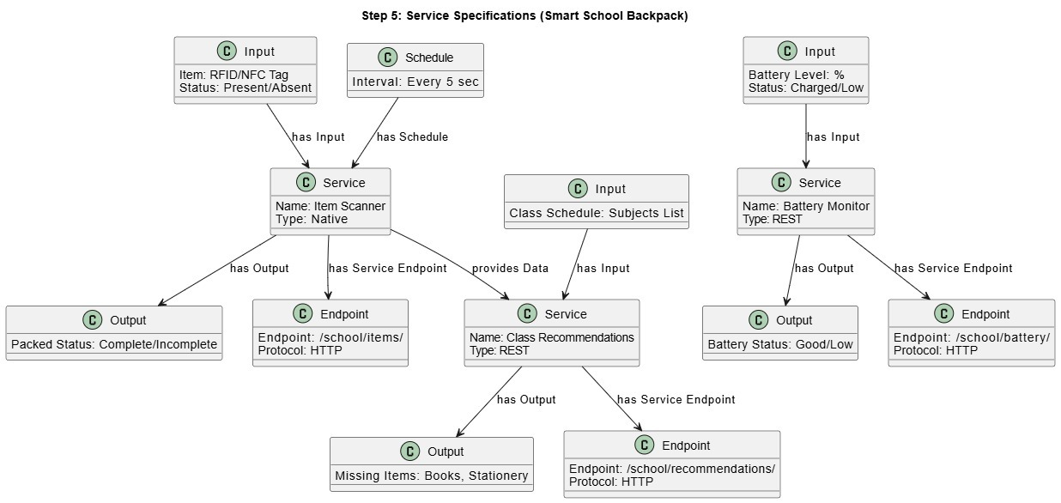
Step 5 – Service Specification
Defines Item Scanning, Class Recommendations, and Battery Monitoring services with RFID/NFC, schedules, and battery levels, outputting packing status, missing items, and battery status via REST APIs

Slide 16
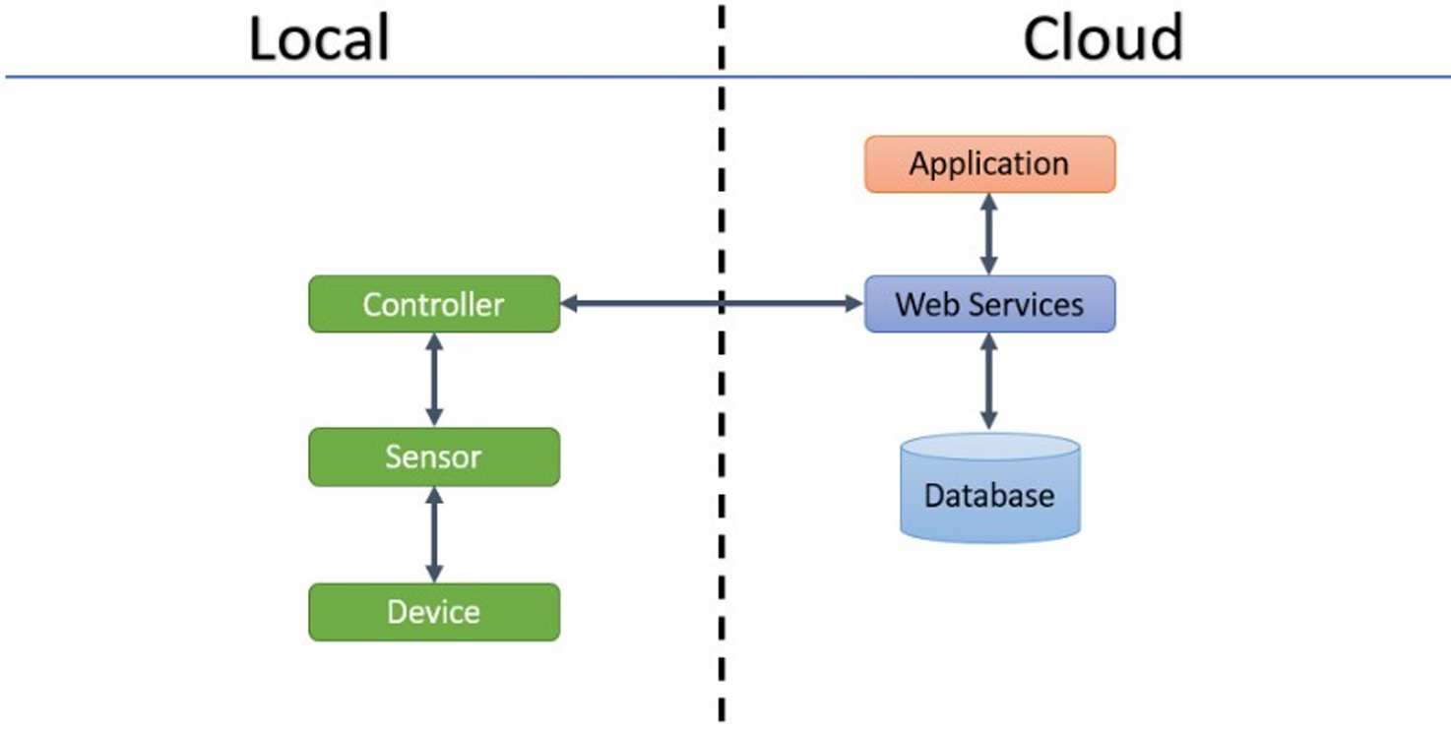
Step 6 – IoT Level Specification
IoT Level 2 cloud data storage and local data analysis

Slide 17
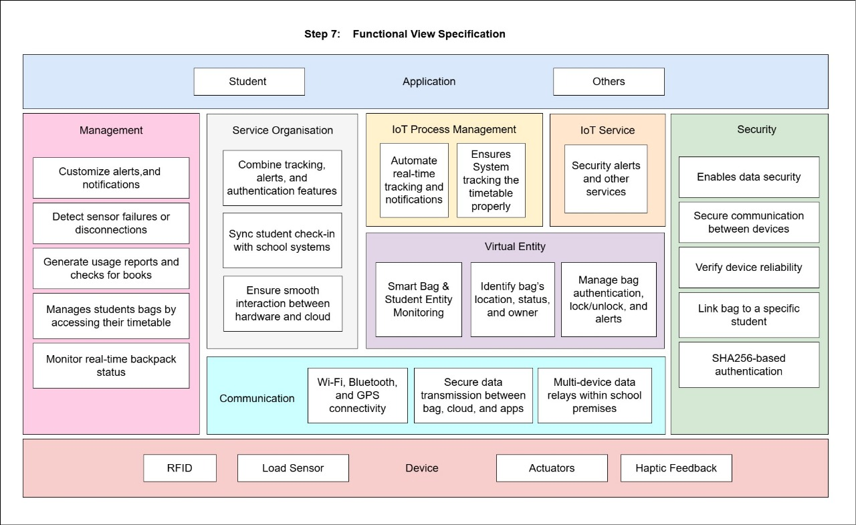
Step 7 – Functional View Specification
Defines Management, IoT Process, Security and Communication for the Smart School Backpack, integrating RFID, Load Sensors, Actuators and Haptic Feedback
with Wi-Fi, Bluetooth, GPS, and SHA256 authentication for real-time tracking, alerts, and authentication.

Slide 18
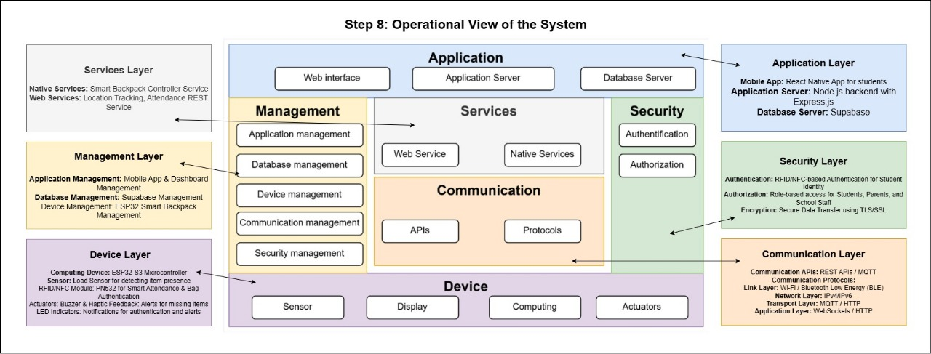
Step 8 – Operational View Specification
Defines Management, IoT Process, Security, and Communication for the Smart School Backpack, integrating RFID, Load Sensors, Actuators, and Haptic Feedback with Wi-Fi, Bluetooth, GPS, and SHA256 authentication for real-time tracking, alerts, and authentication.

Slide 19
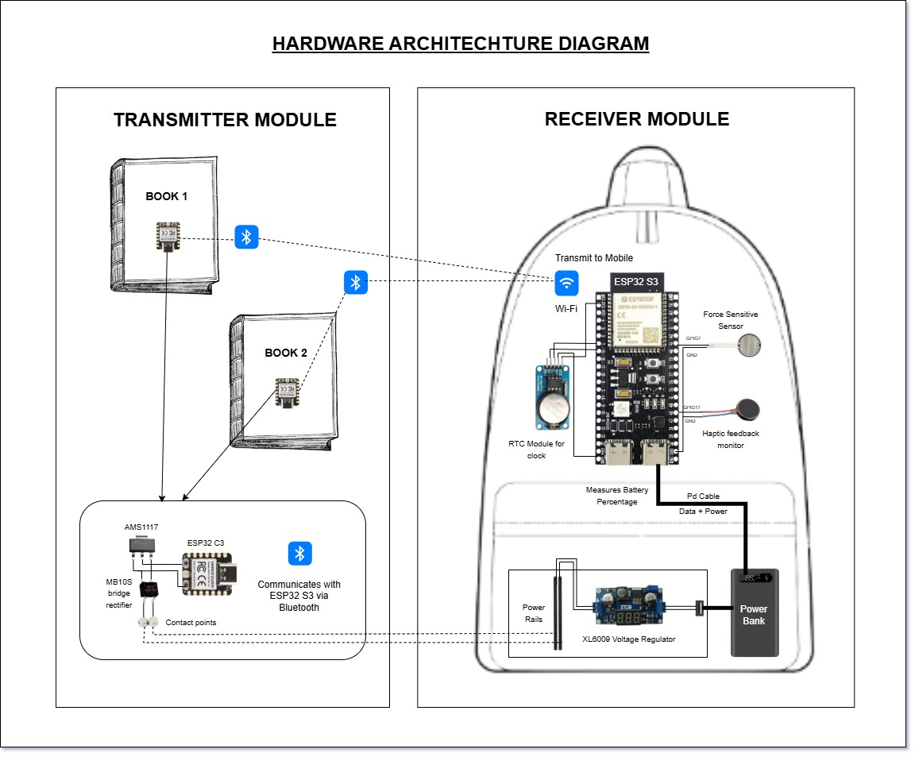
Step 9 – Device and Components Integration
Integrates ESP32-S3 with ESP32 C3, Load Sensor, Haptic Feedback, LEDs, and Battery, enabling seamless communication, sensing, and actuation for Smart Backpack operations

Slide 20
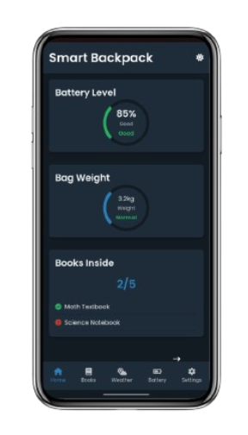
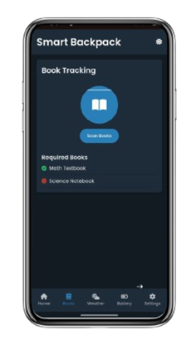
Home Page
Books Page
Step 10 – Application Development
The Smart Backpack app features dark and light themes with sections for Home, Nooks, Weather, Battery, and Settings, ensuring seamless user experience and real-time data management.

Slide 21
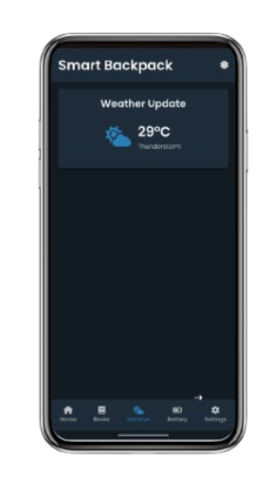
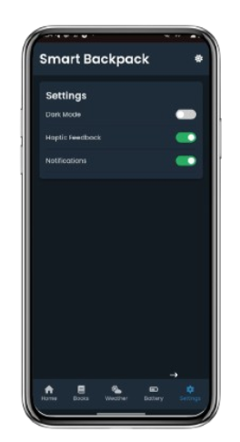
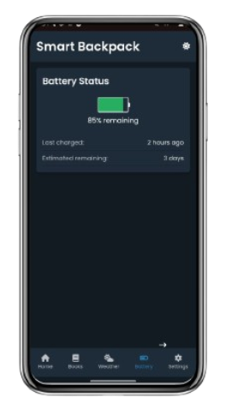
Weather Page
Battery Page
Settings Page

Slide 22
THANK YOU DONE BY, MANOHARAN K (230701177) MONIC AUDITYA a (230701194) MONISH D Y (230701195)

